Slide 1

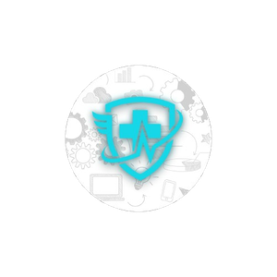
HEALTH MATTERS
Team D
EMPLOYEE WELLBEING REFERRAL SYSTEM
CO2007 Presentation

Slide 2

TEAM
MEMBERS
  Ramiru – Frontend & Backend Developer (Team Leader)
  Sajana – Frontend & Backend Developer
  Omidu – Frontend Developer & UI Designer
  Senula – Backend Developer & Tester
  Thisal – Tester & UI Designer

Slide 3
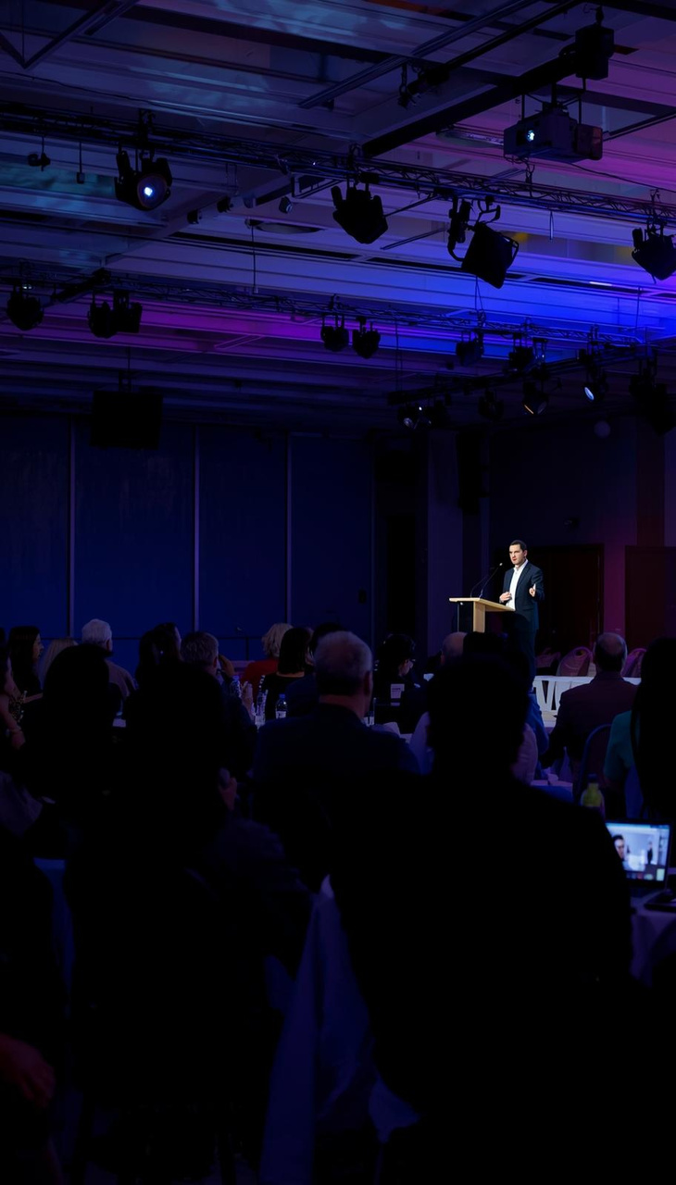
PRESENTATION
AGENDA
  Project Overview
  Project Objectives
  System Architecture
  Module Design
  Agile Development Process
  Testing Strategy
  Test Results
  Working System Demonstration
  Lessons Learned

Slide 4


PROJECT
OVERVIEW
SYSTEM DESCRIPTION
MAIN FEATURES
  Health Matters is a web- based Employee Wellbeing Referral System.
  Role-based dashboards enable managers, empoyees, practitioners, and administrators to generate, oversee, and monitor referrals.
  The web application was developed as a full-stack web system with frontend, backend and database integration.
  Role-based login system
  Referral creation and tracking
  Manager analytics dashboard
  Notification system
  SLA monitoring
  Secure authentication
  Full-stack web application

Slide 5

PROJECT
OBJECTIVES
  This project aimed to develop a full-stack Employee Wellbeing Referral System.
  The system includes role-based dashboards, referral tracking, analytics, and secure authentication using Agile development.
Main Objectives
  Build a full-stack web system
  Create role-based dashboards
  Manage and track referrals
  Show reports and analytics
  Add secure login system
  Use Agile development
  Test the system
  Show working demo

Slide 6




SYSTEM
ARCHITECTURE
  The system was developed using a full-stack architechture.
  The database holds system data, the basckend handles requests and the frontend manages the user interface
  The REST API is used by all components to communicate
Frontend
Backend
Database
  React
  Tailwind CSS
  Vite
  User Interface
  Node.js
  Express API
  Request handling
  Business logic
  MongoDB
  Data storage
  User data
  Referral data

Slide 7



MODULE
DESIGN
  The system was divided into several modules to make development easier.
  Each module handles a different part of the system and all modules work together to form the complete application.
Authentication Module
Referral Module
Dashboard & Analytics
  Login system
  User roles
  Secure authentication
  Access control
  Create referrals
  Track referrals
  Update status
  Notifications
  Manager dashboard
  Reports
  Statistics
  SLA monitoring

Slide 8



AGILE DEVELOPMENT
PROCESS
We used Agile methodology during the development of the system.
The project was completed step by step by dividing tasks, testing regularly, and working together as a team using GitHub.
Planning
Development
Testing
  Product backlogs
  Task division
  Sprint planning
  Team discussions
  Frontend coding
  Backend coding
  Module integration
  GitHub version control
  Manual Functional Testing
  Finding Errors
  Bug fixing
  System improvement

Slide 9

TESTING
OVERVIEW
Purpose of Testing
  The objective of the testing was to ensure that the manager functions of the Health Matters CRM system function properly.
  Testing would be done to make sure that the system performs the necessary functions without defects.
Features Tested
Testing Approach
  MGR-007
  MGR-008
  MGR-009
  MGR-011
  MGR-012
  Manager Dashboard was used to test the system.
  Various tasks were carried out like reviewing information, making referrals, updating records and moving between pages.

Slide 10
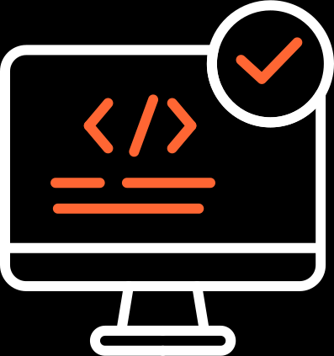
TEST
RESULTS
Results
  Employing all the tested features of the managers proved to work properly in the test stage.
  The system was able to present information, store data and enable managers to make corrections on records
  Browsing through dashboard pages was also error-free.
Test Cases Executed
Conclusion
  Total Test Cases: 5
  Passed: 5
  Failed: 0
  The findings indicate that the manager properties of the system are working normally and the module can be continued to be developed.

Slide 11


WORKING
SYSTEM DEMONSTRATION
  The system was successfully developed and tested.
  The demonstration shows the main features including login, dashboard, referral management, and analytics.
User Login & Dashboard
  Secure login, Role-based access, Manager dashboard and User navigation
Referral & Analytics
  Create referral, Track status, Notifications, Reports & analytics

Slide 12
LESSONS
LEARNED
  During this project, we worked with frameworks that were new to us.
  We learned how to develop a full-stack system, work as a team, and solve problems using Agile methodology.
  This project helped us gain real experience in software development.
Teamwork
Full-Stack Development
  Worked together
  Shared the work
  Good communication
  Solved problems together
  Frontend and backend
  Database connection
  Data sharing
  System working together
Testing & Debugging
Agile Process
  Finding errors
  Fixing bugs
  Improving code
  System testing
  Planning tasks (Using Kanban Boards)
  Rgular Stand Up Meetings
  GitHub usage
  Regular updates through discussions

Slide 13

HEALTH MATTERS
THANK YOU
ANY QUESTIONS?

